Slide 1
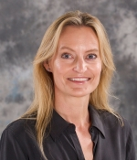
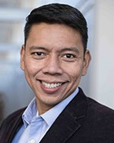
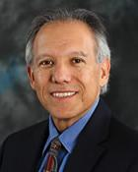
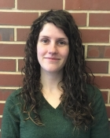
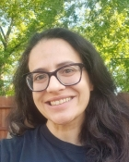



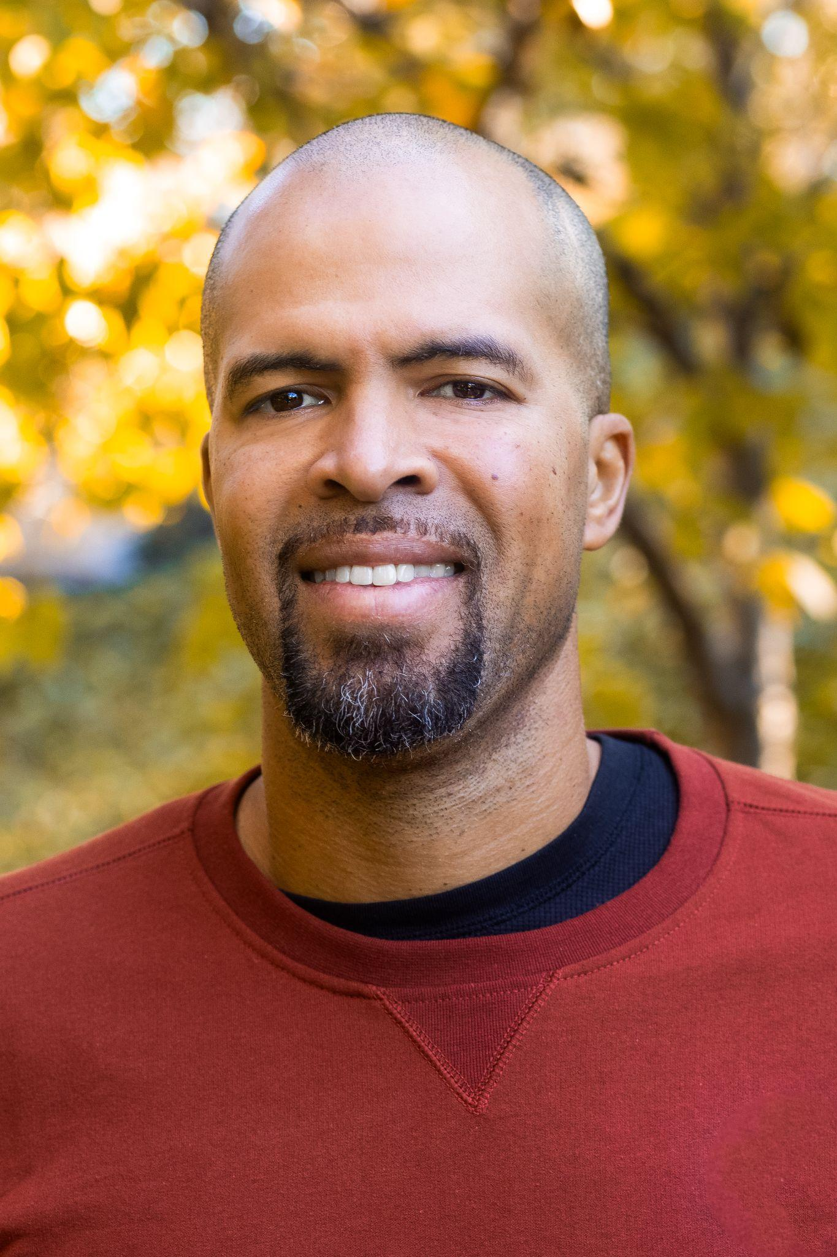
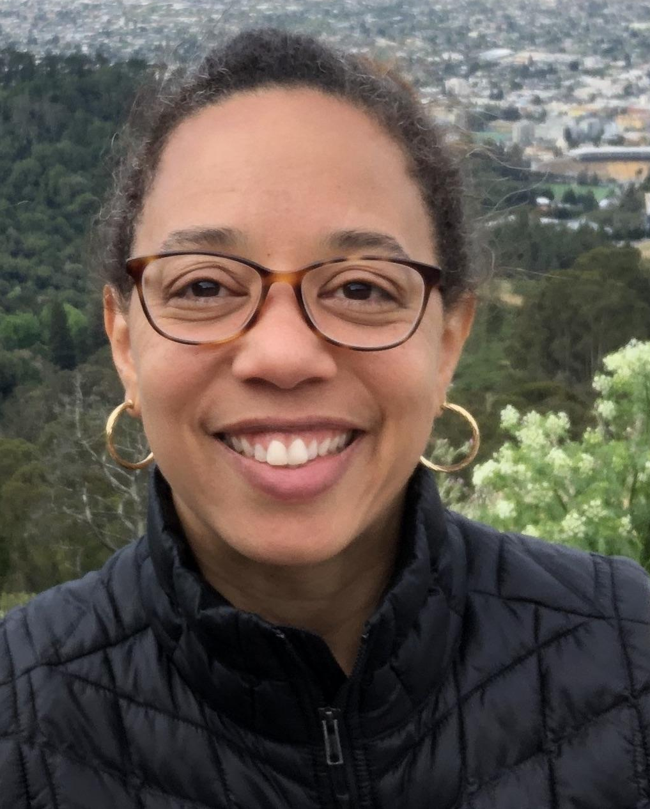

Collaborative Design of Introductory Data Science Course Modules
UC Merced - UC Berkeley - Laney College Project Team
Rosemarie Bongers
Jordan Collignon
Heather Bortfeld
Roummel Marcia
Juan Meza
Erica Rutter
Suzanne Sindi
Adrien Peltzer
UC Merced
Proposal Team
New Additions Teaching Data Science Now!
Johnnie Williams
Nnenna Umollah
Kyla Oh
Laney College

Slide 2
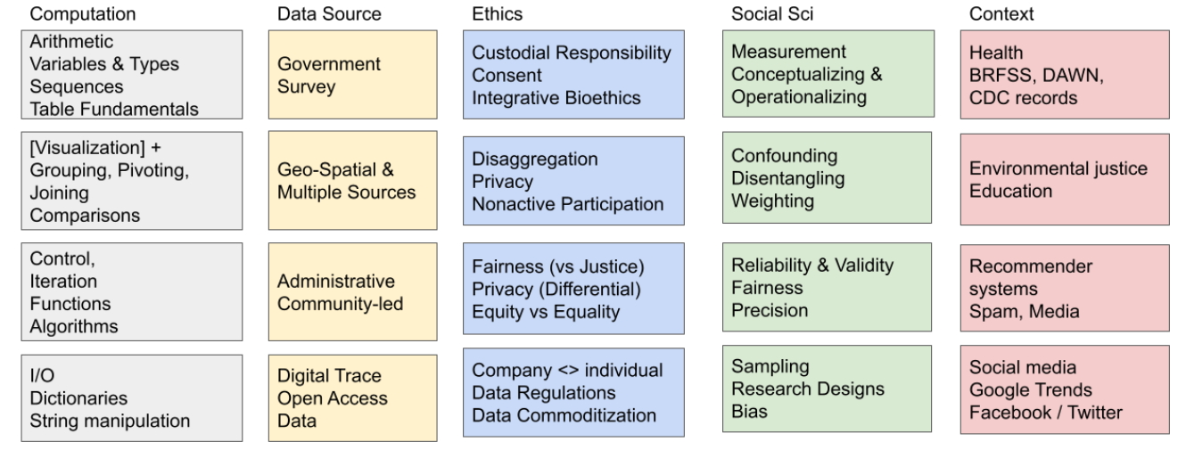
Collaborative Design of Introductory Data Science Course Modules
UC Merced - UC Berkeley - Laney College; Proposed Project
Goal 1. Create open-source, modular introductory DS curriculum at the intersection of computing, statistics, and the social and behavioral sciences.
Goal 2. Build faculty & institutional experience with culturally relevant DS curriculum to attract students with diverse background & interests.
Goal 1. Create open-source, modular introductory DS curriculum at the intersection of computing, statistics, and the social and behavioral sciences.

Slide 3
Collaborative Design of Introductory Data Science Course Modules
UC Merced - UC Berkeley - Laney College; Project Progress
Meeting and Coordination:
Team Coordination at Summer 2023 Data Science Workshop
Bi-Weekly Meetings with inter-campus module teams (4 teams consisting of faculty from all 3 campuses)
Monthly meetings with the entire team
Developing (with Social Scientists) “glossary” of DS terms
Work on course/module design:
UC Merced piloting Hub in Spark 10 course (30 students, open to all disciplines); student data collection beginning.
Laney approval for Math 118 (Data 8), Math 116 (Data 6), AS Degree in Data Science.
UC Berkeley instructors are providing cross-campus instruction and guidance in existing DS materials.
Curriculum Design
All 4 Modules are developing on thoughtful data sets (nutrition, student/gender status, etc)
Model order and connections established (cross team conversations)
Jupyter Notebooks being developed containing core concepts and supporting material related to the fundamentals of programming. The sections included in this Jupyter Notebook are Variables, Data Types, Operators, Reserved Words, Built-In Functions, Memory, Comments, and Indentation.

